Slide 1
COMPOSE INPUT : A DEMONSTRATION OF TEXT INPUT AND VALIDATION WITH ANDROID COMPOSE

Slide 2
DESCRIPTION
The app is a sample project that demonstrates how to use the Android Compose UI toolkit to build a survey app. The app allows the user to answer a series of questions. It showcases some of the key features of the Compose UI toolkit, data management, and user interactions.
Text Input Field : A simple text input area allowing users to type in their data, such as email, username, or password.
Real-time Validation: The entered text will be validated as the user types, providing instant feedback on whether the input meets certain criteria.
Error Messages: Clear error messages or visual indicators (e.g., color changes, icons) when the input is invalid.
Valid Input Handling: When the input is valid, the app can proceed with further actions, such as enabling a submit button.
UI/UX Design: A user-friendly interface using Material Design components for a modern and consistent look and feel.

Slide 3
Main Activity.java:
package com.example.surveyapplication
import android.content.Context
import android.content.Intent
import android.os.Bundle
import androidx.activity.ComponentActivity
import androidx.activity.compose.setContent
import androidx.compose.foundation.Image
import androidx.compose.foundation.layout.*
import androidx.compose.material.*
import androidx.compose.runtime.*
import androidx.compose.ui.Alignment
import androidx.compose.ui.Modifier
import androidx.compose.ui.graphics.Color
import androidx.compose.ui.layout.ContentScale
import androidx.compose.ui.res.painterResource
import androidx.compose.ui.text.style.TextAlign
import androidx.compose.ui.tooling.preview.Preview
import androidx.compose.ui.unit.dp
import androidx.compose.ui.unit.sp
import com.example.surveyapplication.ui.theme.SurveyApplicationTheme

Slide 4
class MainActivity : ComponentActivity() {
private lateinit var databaseHelper: SurveyDatabaseHelper
override fun onCreate(savedInstanceState: Bundle?) {
super.onCreate(savedInstanceState)
databaseHelper = SurveyDatabaseHelper(this)
setContent {
FormScreen(this, databaseHelper)
}
}
}
@Composable
fun FormScreen(context: Context, databaseHelper: SurveyDatabaseHelper) {
Image(
painterResource(id = R.drawable.background), contentDescription = "",
alpha =0.1F,
contentScale = ContentScale.FillHeight,
modifier = Modifier.padding(top = 40.dp)
)

Slide 5
var name by remember { mutableStateOf("") }
var age by remember { mutableStateOf("") }
var mobileNumber by remember { mutableStateOf("") }
var genderOptions = listOf("Male", "Female", "Other")
var selectedGender by remember { mutableStateOf("") }
var error by remember { mutableStateOf("") }
var diabeticsOptions = listOf("Diabetic", "Not Diabetic")
var selectedDiabetics by remember { mutableStateOf("") }
Column(
modifier = Modifier.padding(24.dp),
horizontalAlignment = Alignment.Start,
verticalArrangement = Arrangement.SpaceEvenly
) {
Text(
fontSize = 36.sp,
textAlign = TextAlign.Center,
text = "Survey on Diabetics",
color = Color(0xFF25b897)
)

Slide 6
Spacer(modifier = Modifier.height(24.dp))
Text(text = "Name :", fontSize = 20.sp)
TextField(
value = name,
onValueChange = { name = it },
)
Spacer(modifier = Modifier.height(14.dp))
Text(text = "Age :", fontSize = 20.sp)
TextField(
value = age,
onValueChange = { age = it },
)
Spacer(modifier = Modifier.height(14.dp))
Text(text = "Mobile Number :", fontSize = 20.sp)
TextField(
value = mobileNumber,
onValueChange = { mobileNumber = it },
)

Slide 7
Spacer(modifier = Modifier.height(14.dp))
Text(text = "Gender :", fontSize = 20.sp)
RadioGroup(
options = genderOptions,
selectedOption = selectedGender,
onSelectedChange = { selectedGender = it }
)
Spacer(modifier = Modifier.height(14.dp))
Text(text = "Diabetics :", fontSize = 20.sp)
RadioGroup(
options = diabeticsOptions,
selectedOption = selectedDiabetics,
onSelectedChange = { selectedDiabetics = it }
)
Text(
text = error,
textAlign = TextAlign.Center,
modifier = Modifier.padding(bottom = 16.dp)
)

Slide 8
Button(
onClick = { if (name.isNotEmpty() && age.isNotEmpty() && mobileNumber.isNotEmpty() && genderOptions.isNotEmpty() && diabeticsOptions.isNotEmpty()) {
val survey = Survey(
id = null,
name = name,
age = age,
mobileNumber = mobileNumber,
gender = selectedGender,
diabetics = selectedDiabetics
)
databaseHelper.insertSurvey(survey)
error = "Survey Completed"
} else {
error = "Please fill all fields"
}
},
colors = ButtonDefaults.buttonColors(backgroundColor = Color(0xFF84adb8)),
modifier = Modifier.padding(start = 70.dp).size(height = 60.dp, width = 200.dp)
)

Slide 9
{
Text(text = "Submit")
}
}
}
@Composable
fun RadioGroup(
options: List<String>,
selectedOption: String?,
onSelectedChange: (String) -> Unit
) {
Column {
options.forEach { option ->
Row(
Modifier
.fillMaxWidth()
.padding(horizontal = 5.dp)
) {
RadioButton(
selected = option == selectedOption,
onClick = { onSelectedChange(option) }
)

Slide 10
Text(
text = option,
style = MaterialTheme.typography.body1.merge(),
modifier = Modifier.padding(top = 10.dp),
fontSize = 17.sp
)
}
}
}
}
AdminActivity.kt
package com.example.surveyapplication
import android.os.Bundle
import android.util.Log
import androidx.activity.ComponentActivity
import androidx.activity.compose.setContent
import androidx.compose.foundation.Image
import androidx.compose.foundation.layout.*

Slide 11
"
import androidx.compose.foundation.lazy.LazyColumn
import androidx.compose.foundation.lazy.LazyRow
import androidx.compose.foundation.lazy.items
import androidx.compose.material.MaterialTheme
import androidx.compose.material.Surface
import androidx.compose.material.Text
import androidx.compose.runtime.Composable
import androidx.compose.ui.Modifier
import androidx.compose.ui.graphics.Color
import androidx.compose.ui.layout.ContentScale
import androidx.compose.ui.res.painterResource
import androidx.compose.ui.tooling.preview.Preview
import androidx.compose.ui.unit.dp
import androidx.compose.ui.unit.sp
import com.example.surveyapplication.ui.theme.SurveyApplicationTheme
class AdminActivity : ComponentActivity() {
private lateinit var databaseHelper: SurveyDatabaseHelper
override fun onCreate(savedInstanceState: Bundle?) {
super.onCreate(savedInstanceState)
databaseHelper = SurveyDatabaseHelper(this)

Slide 12
setContent {
val data = databaseHelper.getAllSurveys();
Log.d("swathi", data.toString())
val survey = databaseHelper.getAllSurveys()
ListListScopeSample(survey)
}
}
}
@Composable
fun ListListScopeSample(survey: List<Survey>) {
Image(
painterResource(id = R.drawable.background), contentDescription = "",
alpha =0.1F,
contentScale = ContentScale.FillHeight,
modifier = Modifier.padding(top = 40.dp)
)
Text(
text = "Survey Details",
modifier = Modifier.padding(top = 24.dp, start = 106.dp, bottom = 24.dp),
fontSize = 30.sp,
color = Color(0xFF25b897)
)

Slide 13
Spacer(modifier = Modifier.height(30.dp))
LazyRow(
modifier = Modifier
.fillMaxSize()
.padding(top = 80.dp),
horizontalArrangement = Arrangement.SpaceBetween
) {
item {
LazyColumn {
items(survey) { survey ->
Column(
modifier = Modifier.padding(
top = 16.dp,
start = 48.dp,
bottom = 20.dp
)
) {
Text("Name: ${survey.name}")
Text("Age: ${survey.age}")
Text("Mobile_Number: ${survey.mobileNumber}")

Slide 14
Text("Gender: ${survey.gender}")
Text("Diabetics: ${survey.diabetics}")
}
}
}
}
}
}
RegisterActivity.kt
package com.example.surveyapplication
import android.content.Context
import android.content.Intent
import android.os.Bundle
import androidx.activity.ComponentActivity
import androidx.activity.compose.setContent
import androidx.compose.foundation.Image
import androidx.compose.foundation.background
import androidx.compose.foundation.layout.*
import androidx.compose.material.*
import androidx.compose.runtime.*
import androidx.compose.ui.Alignment
import androidx.compose.ui.Modifier

Slide 15
import androidx.compose.ui.graphics.Color
import androidx.compose.ui.layout.ContentScale
import androidx.compose.ui.res.painterResource
import androidx.compose.ui.text.font.FontFamily
import androidx.compose.ui.text.font.FontWeight
import androidx.compose.ui.tooling.preview.Preview
import androidx.compose.ui.unit.dp
import androidx.compose.ui.unit.sp
import androidx.core.content.ContextCompat
import com.example.surveyapplication.ui.theme.SurveyApplicationTheme
class RegisterActivity : ComponentActivity() {
private lateinit var databaseHelper: UserDatabaseHelper
override fun onCreate(savedInstanceState: Bundle?) {
super.onCreate(savedInstanceState)
databaseHelper = UserDatabaseHelper(this)
setContent {
RegistrationScreen(this,databaseHelper)
}
}
}

Slide 16
@Composable
fun RegistrationScreen(context: Context, databaseHelper: UserDatabaseHelper) {
var username by remember { mutableStateOf("") }
var password by remember { mutableStateOf("") }
var email by remember { mutableStateOf("") }
var error by remember { mutableStateOf("") }
Column(
modifier = Modifier.fillMaxSize().background(Color.White),
horizontalAlignment = Alignment.CenterHorizontally,
verticalArrangement = Arrangement.Center
) {
Image(painterResource(id = R.drawable.survey_signup), contentDescription = "")
Text(
fontSize = 36.sp,
fontWeight = FontWeight.ExtraBold,
fontFamily = FontFamily.Cursive,
color = Color(0xFF25b897),
text = "Register"
)

Slide 17
Spacer(modifier = Modifier.height(10.dp))
TextField(
value = username,
onValueChange = { username = it },
label = { Text("Username") },
modifier = Modifier
.padding(10.dp)
.width(280.dp)
)
TextField(
value = email,
onValueChange = { email = it },
label = { Text("Email") },
modifier = Modifier
.padding(10.dp)
.width(280.dp)
)
TextField(
value = password,
onValueChange = { password = it },
label = { Text("Password") },

Slide 18
visualTransformation = PasswordVisualTransformation(),
modifier = Modifier
.padding(10.dp)
.width(280.dp)
)
if (error.isNotEmpty()) {
Text(
text = error,
color = MaterialTheme.colors.error,
modifier = Modifier.padding(vertical = 16.dp)
)
}
Button(
onClick = {
if (username.isNotEmpty() && password.isNotEmpty() && email.isNotEmpty()) {
val user = User(
id = null,
firstName = username,
lastName = null,
email = email,

Slide 19
password = password
)
databaseHelper.insertUser(user)
error = "User registered successfully"
// Start LoginActivity using the current context
context.startActivity(
Intent(
context,
LoginActivity::class.java
)
)
} else {
error = "Please fill all fields"
}
},
colors = ButtonDefaults.buttonColors(backgroundColor = Color(0xFF84adb8)),
modifier = Modifier.padding(top = 16.dp),
) {
Text(text = "Register")
}
Spacer(modifier = Modifier.width(10.dp))
Spacer(modifier = Modifier.height(10.dp))

Slide 20
Row() {
Text(
modifier = Modifier.padding(top = 14.dp), text = "Have an account?"
)
TextButton(onClick = {
context.startActivity(
Intent(
context,
LoginActivity::class.java
)
)
})
{
Spacer(modifier = Modifier.width(10.dp))
Text( color = Color(0xFF25b897),text = "Log in")
}
}
}
}
private fun startLoginActivity(context: Context) {
val intent = Intent(context, LoginActivity::class.java)
ContextCompat.startActivity(context, intent, null)
}

Slide 21
AndroidMainfest.xml
<?xml version="1.0" encoding="utf-8"?>
<manifest xmlns:android="http://schemas.android.com/apk/res/android"
xmlns:tools="http://schemas.android.com/tools">
<application
android:allowBackup="true"
android:dataExtractionRules="@xml/data_extraction_rules"
android:fullBackupContent="@xml/backup_rules"
android:icon="@mipmap/ic_launcher"
android:label="@string/app_name"
android:supportsRtl="true"
android:theme="@style/Theme.SurveyApplication"
tools:targetApi="31">
<activity
android:name=".RegisterActivity"
android:exported="false"
android:label="@string/title_activity_register"
android:theme="@style/Theme.SurveyApplication" />
<activity
android:name=".MainActivity"

Slide 22
android:exported="false"
android:label="MainActivity"
android:theme="@style/Theme.SurveyApplication" />
<activity
android:name=".AdminActivity"
android:exported="false"
android:label="@string/title_activity_admin"
android:theme="@style/Theme.SurveyApplication" />
<activity
android:name=".LoginActivity"
android:exported="true"
android:label="@string/app_name"
android:theme="@style/Theme.SurveyApplication">
<intent-filter>
<action android:name="android.intent.action.MAIN" />
<category android:name="android.intent.category.LAUNCHER" />
</intent-filter>
</activity>
</application>
</manifest>

Slide 23
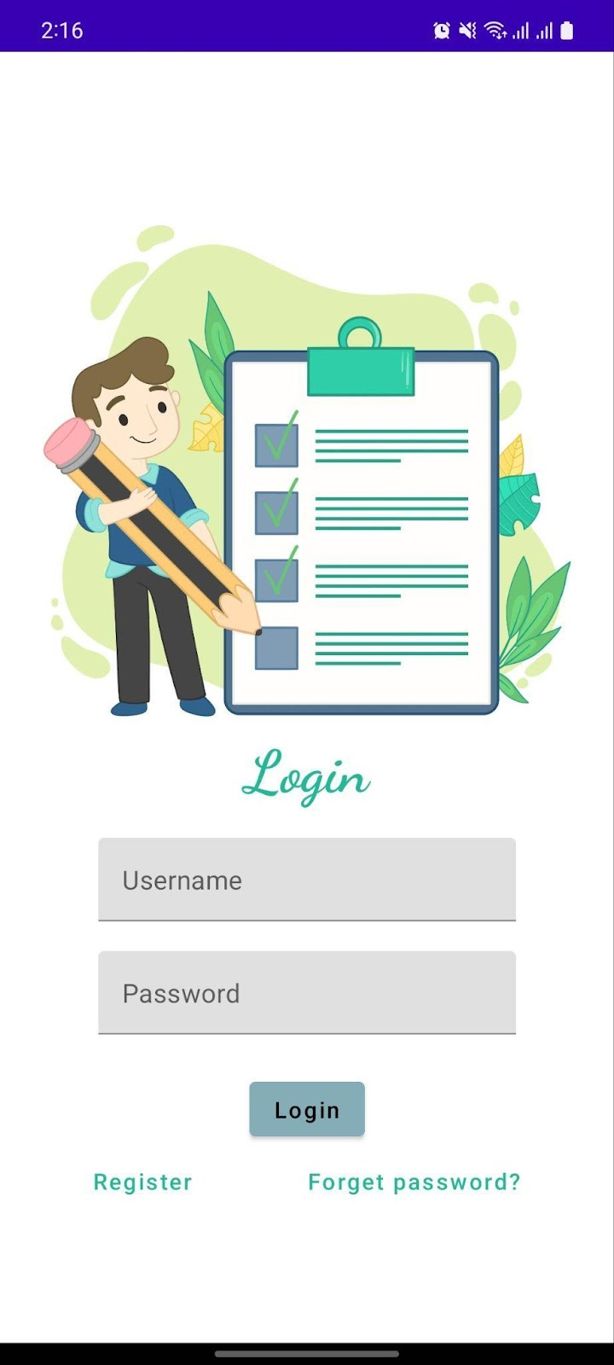
OUTPUT:
Login Page:

Slide 24
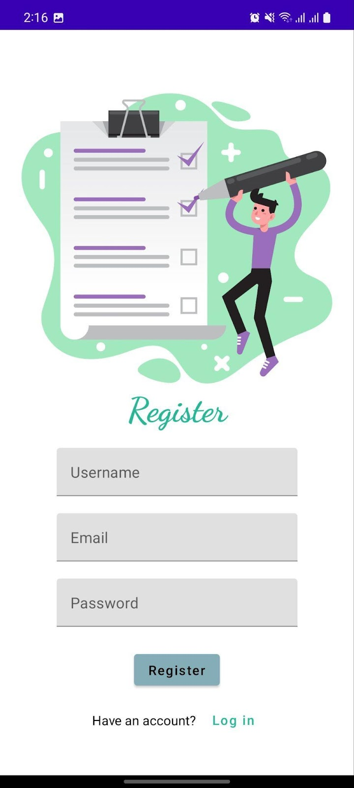
Register Page :

Slide 25
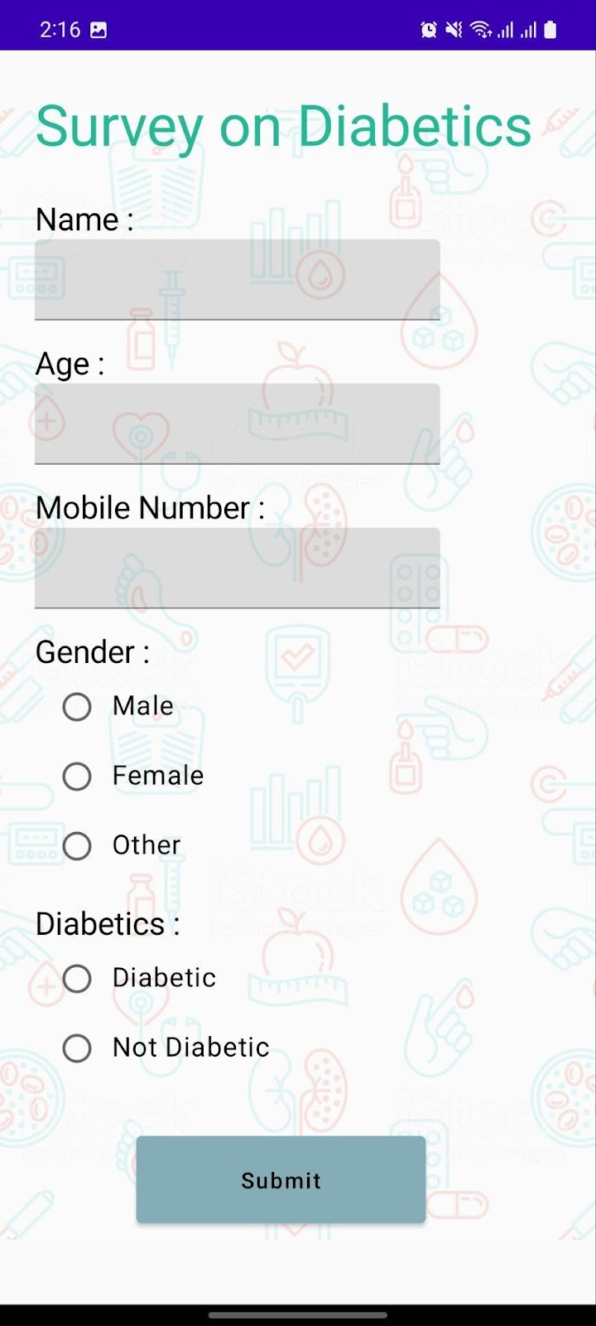
Main Page :

Slide 26
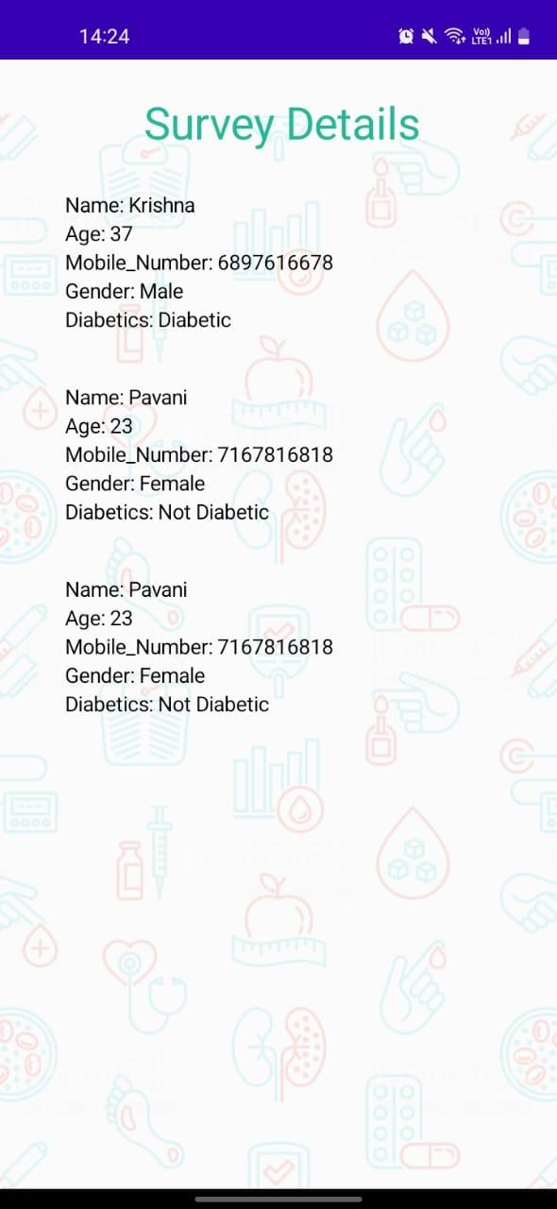
Survey Details:

